Slide 1
Introduction to Coursework 2
Microstrip Stepped Impedance Filter
Learning Objectives:
To understand the process of microwave filter design;
To understand the process of mapping desired capacitance and inductance to printed circuit components (microstrip line);
To understand the relationship between characteristic impedance and microstrip line dimensions;
Understand and use S parameters for filter design;
Learn how to use a commercial package!
Design a practical microwave low-pass filter operating at 4 GHz!

Slide 2
H63MCM Coursework Stepped-impedance low pass filter design
Microwave low-pass filter design
25% of the total mark
Coursework is worth 5 credits = 50 hours of your work

Slide 3
g₁=L₁
g₃=L
g_{N}=L
Lowpass filter prototype
g₀=1
…
+
g₂=C₁
g₄=C₂
g_{N-1}=C
g_{N+1}=1
Low pass prototype filter
filter
50Ω line
50Ω line
Low pass stepped-impedance filter

Slide 4
Filter design process
Defining filter characteristics and deciding on the filter order
Select the appropriate lowpass prototype network
Scaling of the prototype to microwave frequencies
Transforming lumped components to transmission line equivalents
Filter layout - Convert the transmission lines to physical parameters of microstrip lines

Slide 5
Defining filter characteristics- Buterworth (maximally flat) filter
Ideal filter
N=5
ILmin for N=5
N=4
ILmin for N=4
ILmin for N=3
N=3
ω_{c}
IL_{max}
Filter characteristics: Design a maximally flat low-pass filter prototype that has the cut-off frequency at 4 GHz, maximum insertion loss in the passband of 0.5 dB, at least 14dB attenuation at 5 GHz and input and output impedance of 50Ω.

Slide 6
Step 1: Based on filter specification determine appropriate order of the filter
Design a maximally flat low-pass filter that has the cut-off frequency at 4 GHz, maximum insertion loss in the passband of 0.5 dB, at least 14dB attenuation at 6 GHz and input and output impedance of 50Ω. Filter is to be realised in the microstrip circuit technology.
Appropriate order N:
Maximally flat filter:

Slide 7
Step 2: Select the prototype filter
g₁=L₁
g₃=L
g_{N}=L
g₀=1
…
+
g₂=C₁
g₄=C₂
g_{N-1}=C
g_{N+1}=1
Lowpass prototype – normalised in the terms of impedances and frequency

Slide 8


Step 3. Scaling of the prototype filter to microwave frequencies (limped filter components)
Impedance scaling with impedance R_{o}
Frequency scaling – at the cut-off freq ω_{c}
$$L^{′}=\frac{RoL}{ωc}$$
$$C^{′}=\frac{C}{Roωc}$$

Slide 9
Step 4. Convert the lumped components into the ideal transmission line equivalent circuits
Converting L and C into equivalent transmission lines (here L and C are scaled values with impedance and frequency)
βl
L
Z_{oL}
βl
C
Z_{cC}

Slide 10
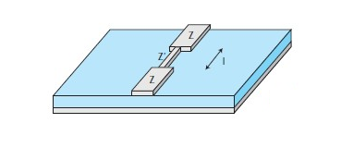
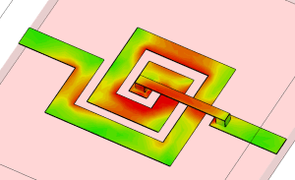
Inductors and capacitors in microstrip technology
When we reduce the width of the microstrip line we increase the characteristic impedance.
Inductance is realised with short sections of high impedance line
Another way to realise inductor is:
βl
L
Z_{o}
θ is the electrical length
Current distribution on a microstrip spiral inductor https://www.cst.com/Applications/Article/Spiral+Inductor

Slide 11
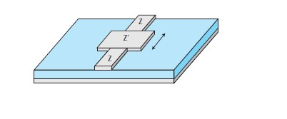
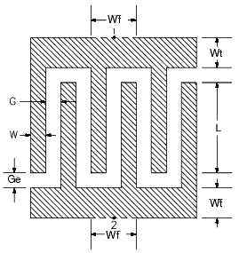
Capacitor is realised with a wide section of low impedance (effectively the microstrip line and the ground plane form a capacitance)
Or alternatively – as microwave interdigital capacitor:
βl
C
Z_{oC}
http://cp.literature.agilent.com/litweb/pdf/ads2008/ccdist/ads2008/MICAP1_(Microstrip_Interdigital_Capacitor_(2-port)).html

Slide 12
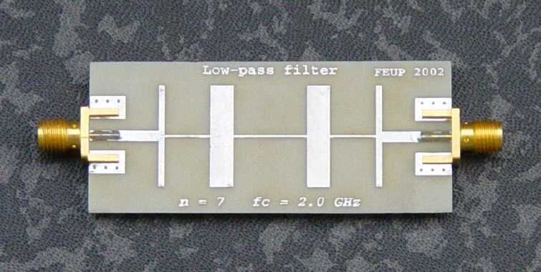
Filter layout
Step 5. Use microstrip design formulae to convert transmission lines to microstip lines
ADS software – 4th floor Lob in the Tower building
filter
50Ω line
50Ω line
Low pass stepped-impedance filter

Slide 13
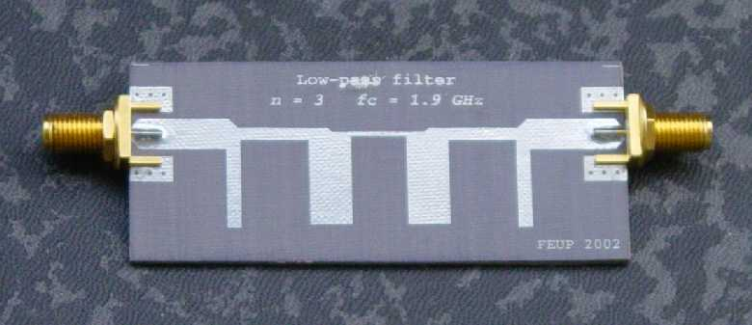
Other low-pass filters…
Commensurated-line low-pass filter
http://paginas.fe.up.pt/~hmiranda/etele/microstrip/

Slide 14
Microstrip technology – use Linecalc tool in ADS
W
h
ε_{r}
Synthesis:
For a given characteristic impedance, Z_{o} and substrate ε_{r}, the ratio W/d can be found as:

Slide 15
Microstrip technology – use Linecalc tool in ADS
W
h
ε_{r}
Analysis:
Given the characteristics of microstrip line (W, h, ε_{r}) we can find out the characteristic impedance, Z_{o}:
Effective dielectric constant

Slide 16
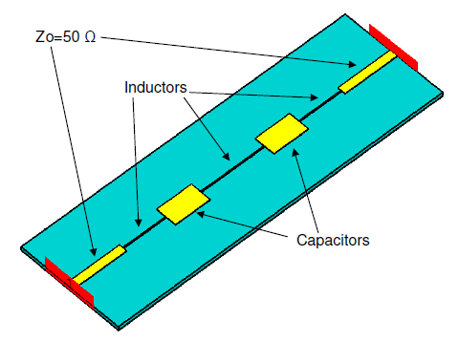
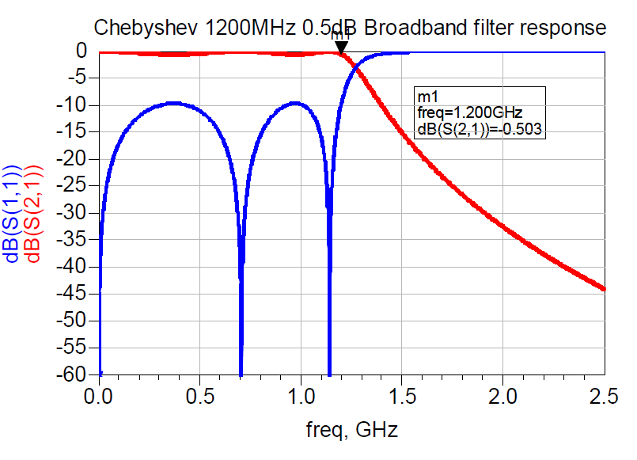
http://antenna.mppa.gr/stepped_Z_filter_low_pass.html

